Slide 1
How to Make a Bar Graph
Erica Dube
Emma Bodner
Elanur Akin

Slide 2
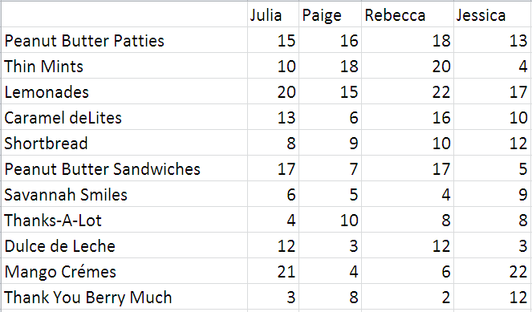
Add the Desired Information

Slide 3
Go to Insert and Choose Bar Chart

Slide 4
Drop Down on the Bar Chart and Choose the Desired Style

Slide 5
Once you Choose the Style you want, Click on it

Slide 6
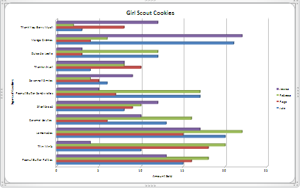
Your bar graph should appear with the information you typed

Slide 7
You may also personalize your bar chart by using different tools

Slide 8
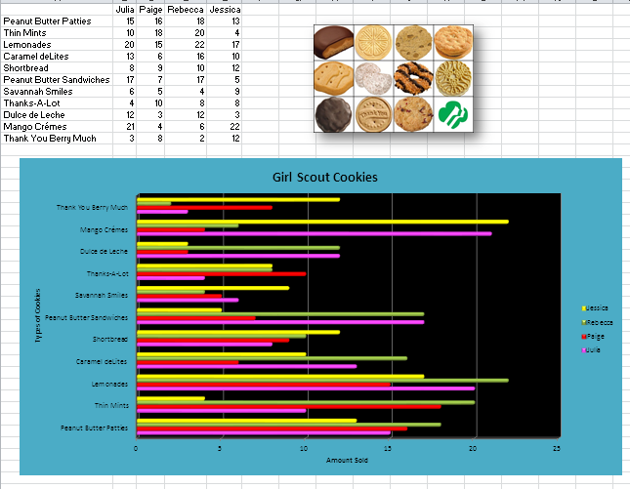
You have now learned how to make a bar chart !

